Slide 1


Carbon Fiber
Tulin Kale & Vishvajeet Mane
Feb 2025

Slide 2
Change history
Issue | Description | Date | Owner
01 | New Document | 31-12-2025 | Tulin Kale/Vishvajeet Mane

Slide 3
INDEX
Carbon Fibre - Introduction
Carbon Fiber- History
Carbon Fiber - Uses in Automotive Industry
Why Carbon Fiber is Used in Cars?
Carbon Fiber Manufacturing Process
Carbon Fiber Fabric styles
Three Methods for Creating Carbon Fiber Parts
Carbon Fiber 3D Printing
LOCATOR AND FIXING STRATEGY
Design Guidelines- Part Thickness
Design Guidelines- Fixing Clip distance
Design Guidelines- Z Resting
Design Guidelines- X Resting
Design Guidelines-Minimum Radii
Design Guidelines- Edge Condition
Design Guidelines- Abruption In Filleting
Design Guidelines- Undercut in Tool
Design Guidelines- Draft Angle
Design Guidelines- Sharpe Condition
Design Guidelines- Uneven Edge
Fixing Type
Assembly Path
Y=0 Section

Slide 4
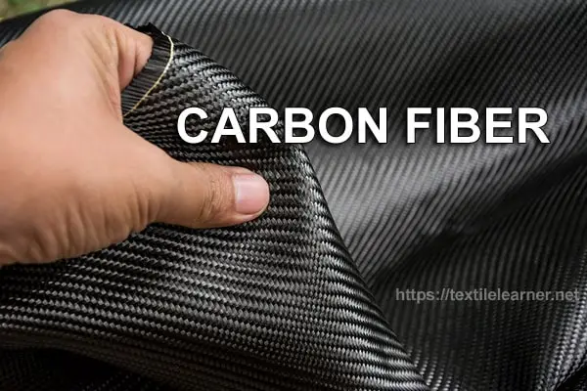
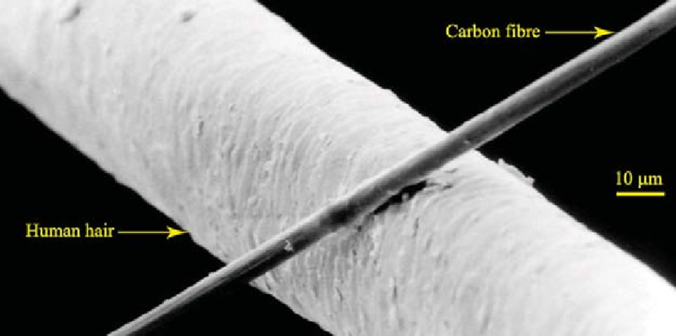
Carbon Fiber - Introduction
Carbon Fiber is a polymer and is sometimes known as graphite fiber.
It is a very strong material that is also very lightweight.
Carbon fiber is five-times stronger than steel and twice as stiff.
Though carbon fiber is stronger and stiffer than steel, it is lighter than steel; making it the ideal manufacturing material for many parts
Carbon fiber can be thinner than a strand of human hair and gets its strength when twisted together like yarn.
Carbon fibers are fibers about 5–10 micrometers in diameter. Several thousand carbon fibers are bundled together to form a tow, which may be used by itself or woven into a fabric.

Slide 5
Carbon Fiber - History
Carbon fiber dates back to 1879 when Thomas Edison baked cotton threads or bamboo silvers at high temperatures, which carbonized them into an all-carbon fiber filament. By 1958, high-performance carbon fibers were invented just outside of Cleveland, OH. Although they were inefficient, these fibers contained around 20% carbon and had low strength and stiffness properties.
In 1963 a new manufacturing process was developed at a British research center, which is where carbon fiber’s strength potential was realized.
How is Carbon Fiber Made: An Overview of The Carbon Fiber Manufacturing Process
Carbon fiber is made from a process that is part chemical and part mechanical. It starts by drawing long strands of fibers and then heating them to a very high temperature without allowing contact to oxygen to prevent the fibers from burning. This is when the carbonization takes place, which is when the atoms inside of the fibers vibrate violently, expelling most of the non-carbon atoms. This leaves a fiber composed of long, tightly inter-locked chains of carbon atoms with only a few non-carbon atoms remaining.
A typical sequences used to form carbon fibers from polyacrylonitrile involves spinning, stabilizing, carbonizing, treating the surface and sizing.

Slide 6
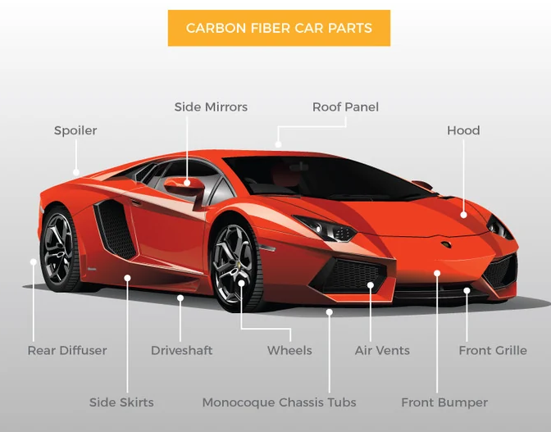
Carbon Fiber - Uses in Automotive Industry
Hood
Spoiler
Car Doors
Roof
Diffuser
End Caps
Splitter
Mirror

Slide 7
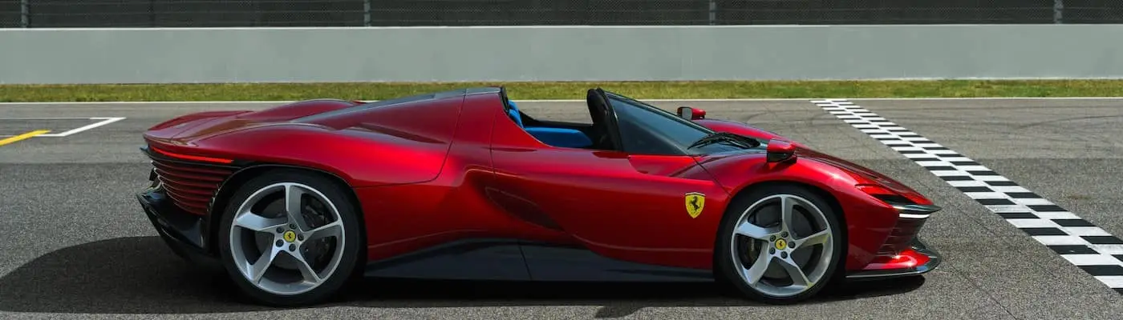
Why Carbon Fiber is Used in Cars?
Carbon fiber is used in cars to lower weight while providing enough strength to withstand the rigors of racing.
You’ll notice that supercars and hyper cars the world over place a premium on lowering their weight in addition to increasing engine output and refining their aerodynamic designs — and lowering weight is precisely what carbon fiber is good for in a car.
Carbon fiber is five times lighter than steel while being less dense than aluminum, which is one of the lightest metals available.
In a contest between two otherwise identical cars, the vehicle with carbon fiber parts is likely to outperform the model with parts made from traditional materials, because shedding weight allows it to make the most of its powertrain.

Slide 8


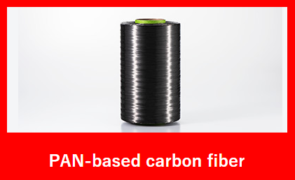
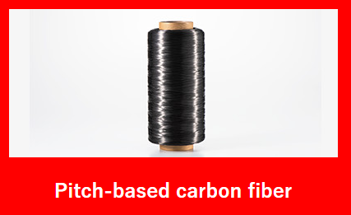
Carbon Fiber Manufacturing Process
Carbon fiber raw materials from two types of Raw Materials: PAN and pitch.
PAN Route:
Polymerization → Spinning → Heat Stabilization (200–300°C) → Carbonization/Graphitization (1000–3000°C) → Final Treatments (Surface Treatment & Sizing) → PAN Fiber
Pitch Route:
Dry Distillation → Spinning → Heat Stabilization (200–300°C) → Carbonization/Graphitization (1000–3000°C) → Final Treatments (Surface Treatment & Sizing) → Pitch Fiber

Slide 9
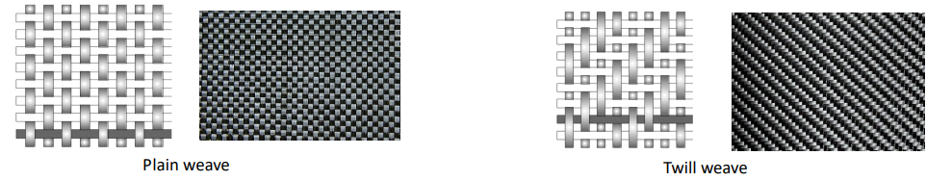
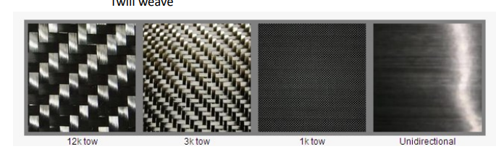
Carbon Fiber Fabric styles
Woven
Most fabric constructions offer more flexibility for lay-up of complex shapes than straight unidirectional tapes offer. Fabrics used for structural applications use like fibers or strands of the same weight or yield in both the warp (longitudinal) and weft (transverse) directions.
Carbon Fibers are actually quite small. Fibers are bundled together to make yarns.
The Yarns, are in many sizes:–
Small Tow: 3K, 12K, 24K
Large Tow: Larger than 24K
Carbon Fiber Tow is the thread used to weave carbon fiber fabrics. This 24K tow (or yarn) is composed of 24,000 individual carbon filaments.
3K means there are 3,000 filaments per "tow". 12K means there are 12,000 filaments per "tow".
UD and 3k weave are more and more popular,

Slide 10
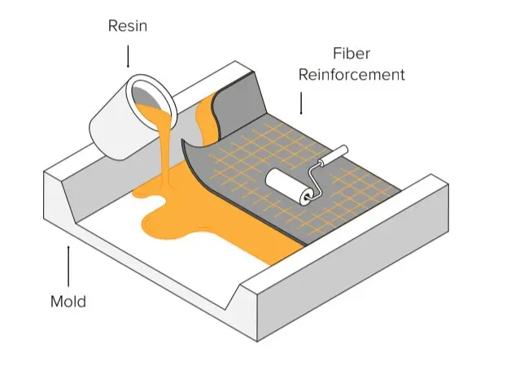
Three Methods for Creating Carbon Fiber Parts
1. Wet Lay-Up
In wet lay-up, the fiber is cut and laid into the mold then resin is applied via a brush, roller, or spray gun. This method requires the most skills to create high-quality parts, but it is also the least expensive workflow with the lowest requirements to get started with making DIY carbon fiber parts. If you are new to carbon fiber parts manufacturing and not equipped yet, we would recommend starting with wet lay-up hand lamination.

Slide 11
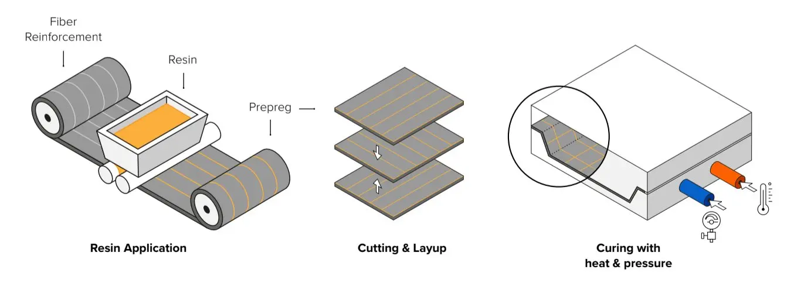
Three Methods for Creating Carbon Fiber Parts
2. Prepreg Lamination
With prepreg lamination, the resin is infused in the fiber ahead. Pre-impregnated sheets are stored cold to inhibit the cure. Plies are then cured into the mold under heat and pressure in an autoclave. This is a more precise and repeatable process because the quantity of resin is controlled but it is also the most expensive technique that is usually used in high-performance applications.

Slide 12
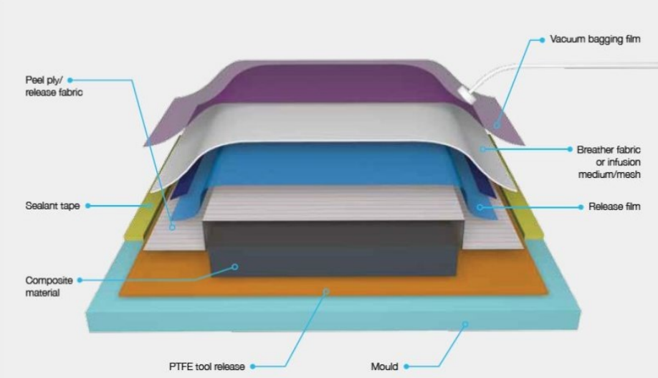
Three Methods for Creating Carbon Fiber Parts
2. Prepreg Vacuum bag process
Consumables for vacuum bag processing :
Release agent :
Help the cured prepreg part come off the tool easily.
Peel ply (optional):
It allows vapors and extra resin pass during curing. After curing, it can be removed to leave a surface ready for bonding or painting.
Bleeder fabric (optional):
Made of felt or glass fabric, it absorbs extra resin. The amount of bleeder controls resin flow to achieve the desired fiber content.
Release film:
It stops excess resin flow and lets air and vapors pass through tiny holes to the breather layer above.
Breather fabric:
Helps create vacuum and removes air and vapors from the assembly. Thicker breathers are used for high autoclave pressures.
Edge dam:
Keeps resin contained and maintains the part’s shape.
Vacuum bag/sealant tape:
Creates a sealed bag so air can be removed to form a vacuum.
It is recommended that new consumables are used each time to ensure the manufacture of good quality components.

Slide 13
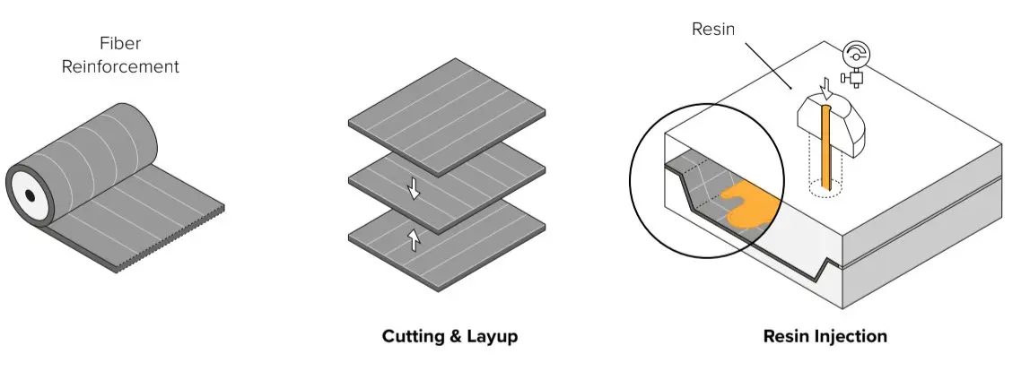
Three Methods for Creating Carbon Fiber Parts
3. Resin transfer molding (RTM)
With RTM molding, the dry fiber is inserted into a two-part mold. The mold is clamped shut before forcing the resin into the cavity at high pressure. It is usually automated and used for larger volume manufacturing.

Slide 14
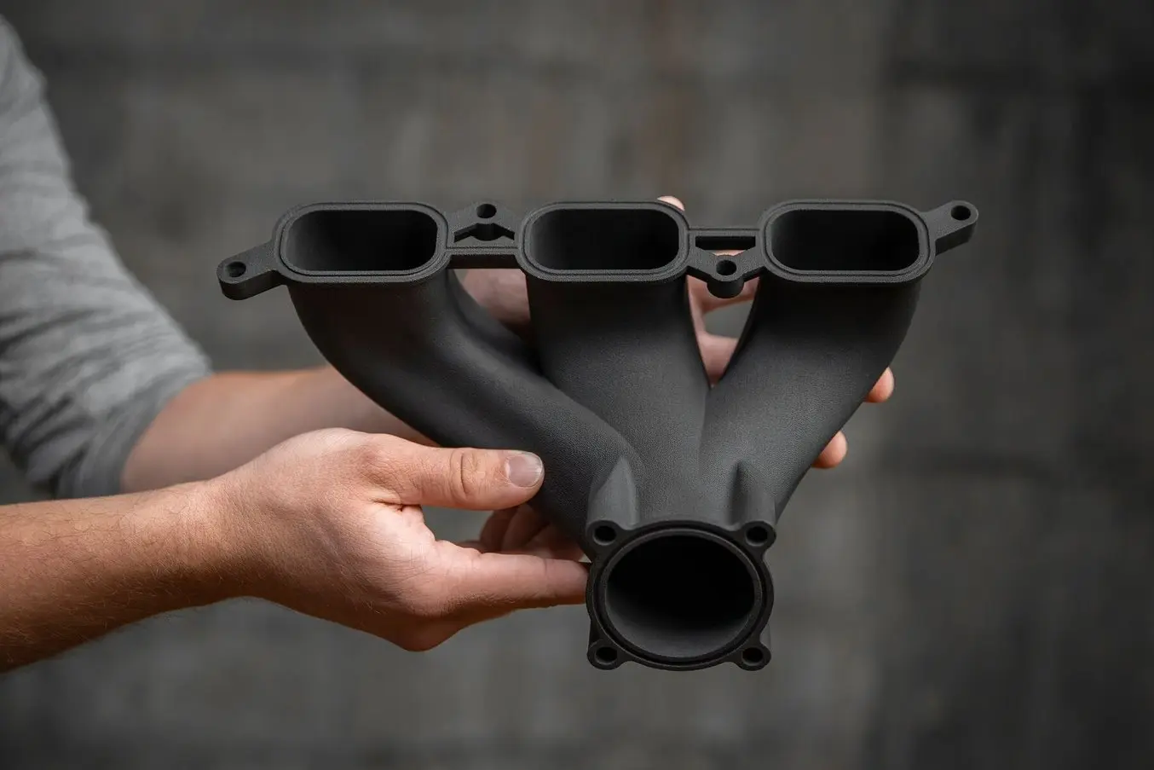
Carbon Fiber 3D Printing
There is strong demand for workflows that combine the strength, durability, and ruggedness of traditional carbon fiber parts with the agility, geometric possibilities, and repeatability of 3D printing. It’s therefore not surprising that there are many 3D printing companies that offer carbon fiber 3D printing, with the two currently available processes being printing with chopped fibers or continuous fibers.
Using chopped carbon fibers, Nylon 11 CF Powder for the Fuse 1+ 30W selective laser sintering (SLS) industrial 3D printer enables manufacturers to create strong, lightweight, and heat-resistant parts, without relying on traditional overlay or machining methods.
Formlabs Nylon 11 CF Powder is strong, lightweight, and heat resistant, making it ideal for automotive, aerospace, and manufacturing applications

Slide 15
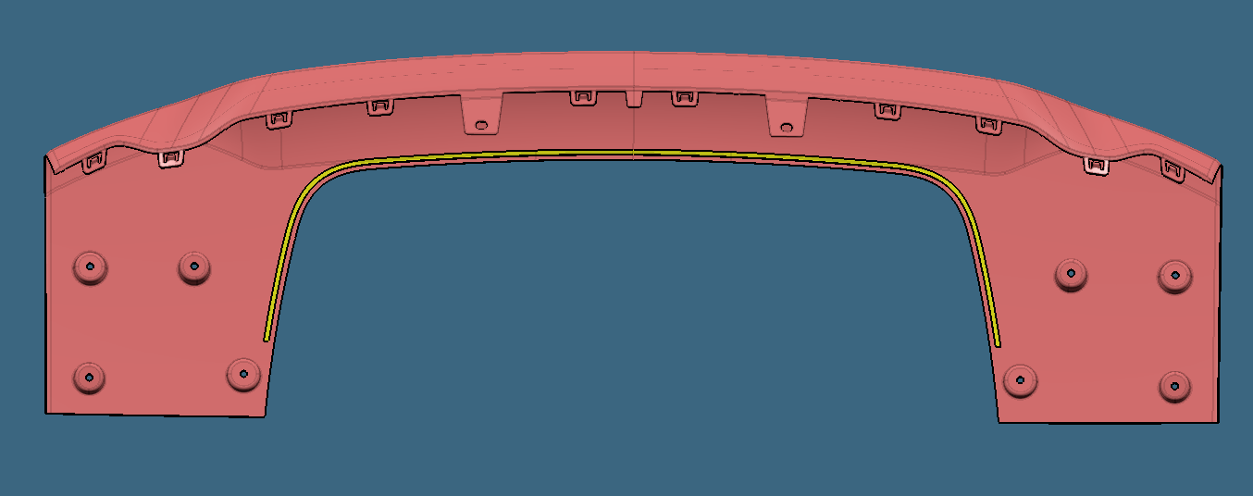
LOCATOR AND FIXING STRATEGY
X Resting
Y Locators
X Resting
Snap
Snap
Snap
Z Resting
Z Resting
Z Resting

Slide 16
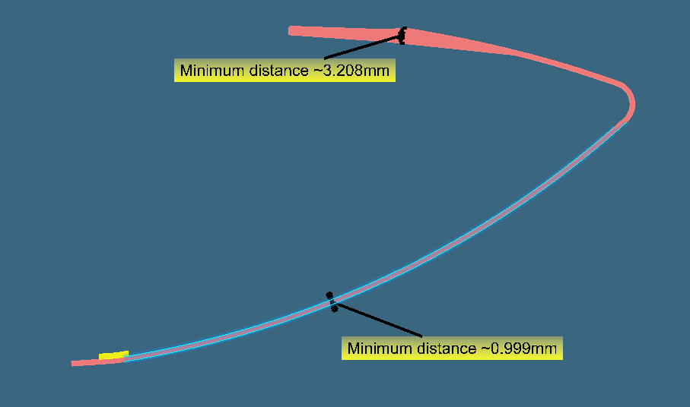
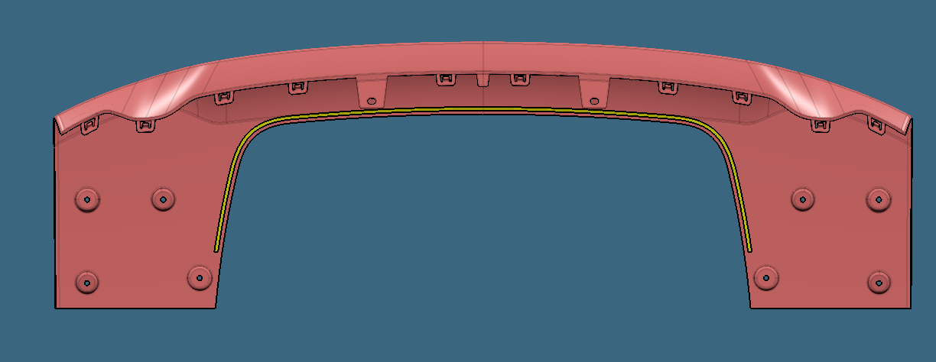
Design Guidelines
Part Thickness
A
Section A-A
A
Part thickness of the carbon fiber : 1 mm to 1.4 mm depends on the requirement.
Flange thickness can be made to 3mm for fixing with surrounding parts.

Slide 17
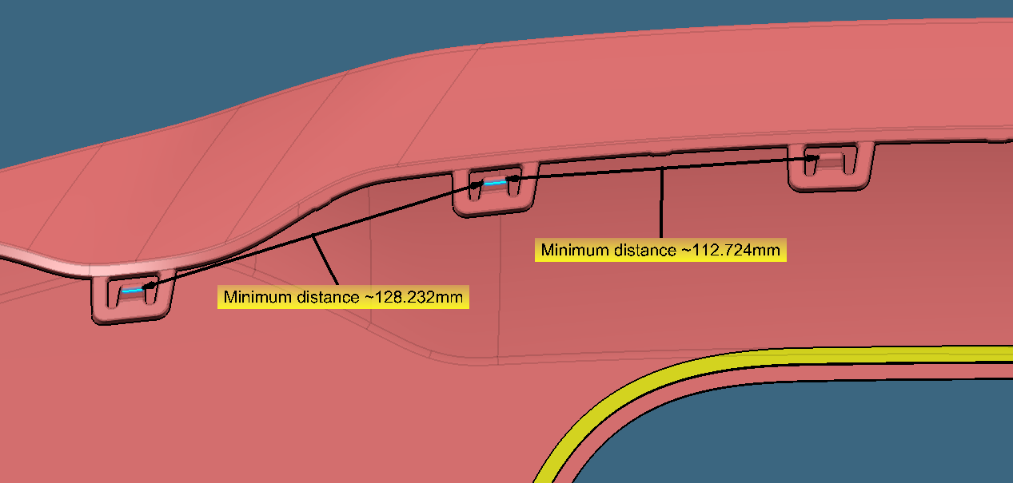
Design Guidelines
Fixing Clip distance
Fixing clips/positive fixing to be kept at 100-150mm apart from each other.

Slide 18
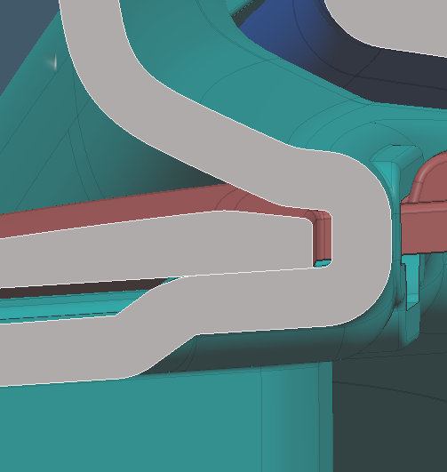
Design Guidelines
Z resting
Carbon Fiber
Touching Condition
Plastic Interface
Z resting of the part to be provided as per 3-2-1 principle.

Slide 19
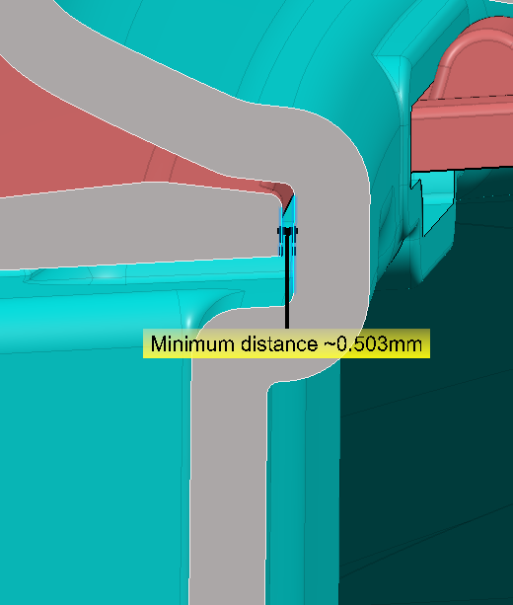
Design Guidelines
X resting
Section A-A
A
A
X resting of the part to be provided as per 3-2-1 principle.
** Supplier Requirement: For Carbon fiber parts X support does not rest on the C channel face as the carbon fiber material is stiff it might result the clips to not engage during fixing hence need to keep a gap of 0.5mm instead of resting.

Slide 20
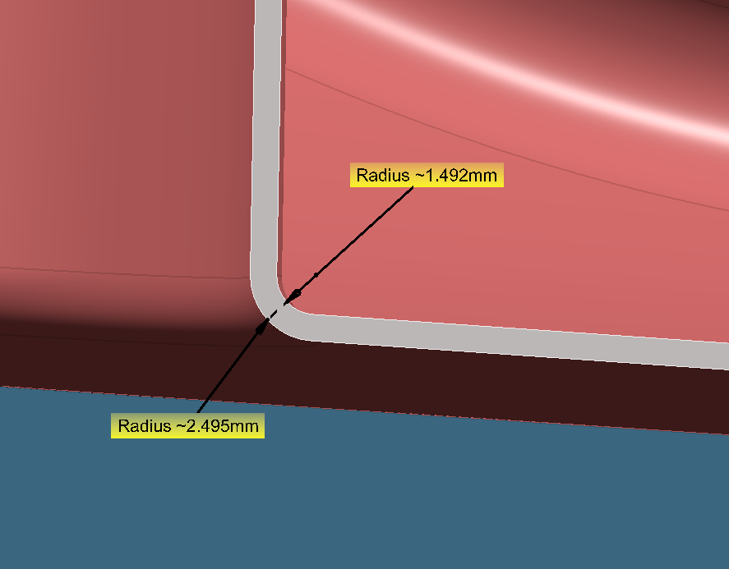
Design Guidelines
MINIMUM RADII
The minimum radii allowed are 1mm. Lower values may be used only if appropriate DFM has been carried out with the supplier of the component.

Slide 21
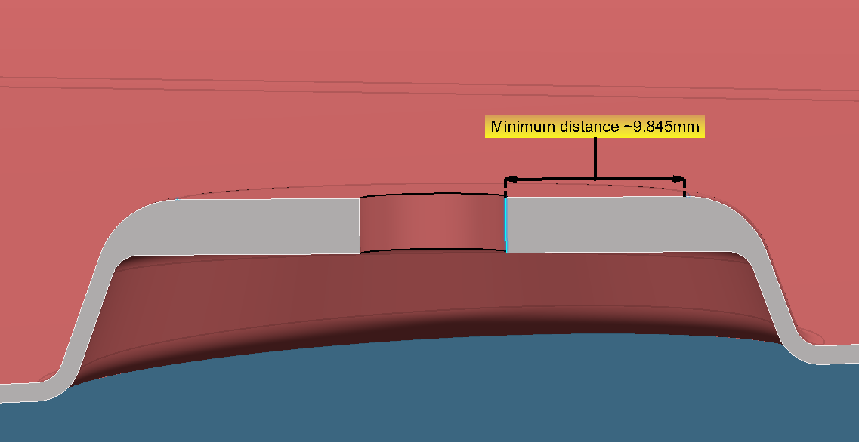
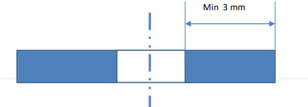
Design Guidelines
EDGE CONDITION
The minimum distance allowed are 3mm. Lower values may be used only if appropriate DFM has been carried out with the supplier of the component.
For plastic parts also any hole, slot or similar feature should maintain a minimum edge distance of 3mm.

Slide 22
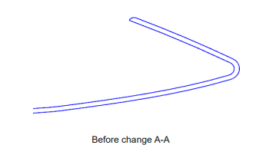

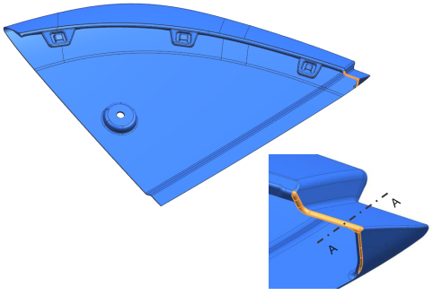
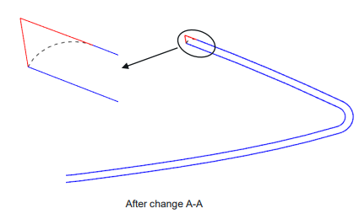

Design Guidelines
Abruption In Filleting
Yellow highlighted surface has abrupted in filleting

Slide 23
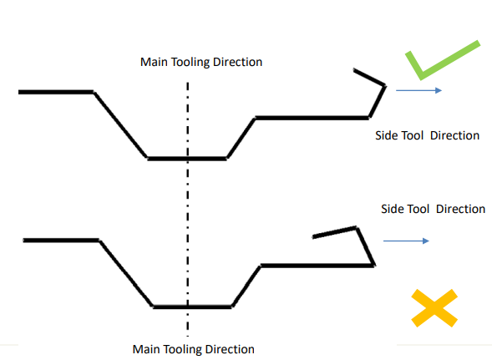
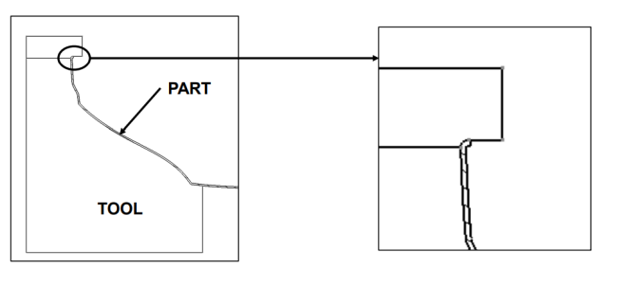
Design Guidelines
Undercut in Tool
In areas where the molded surface is required to extend beyond the constraints of being visible in the tooling direction to create an undercut or lower molded return surface, additional tooling is required Any Undercut in Main tooling need Separate tool
Provide sufficient draft for Side tool if it is needed

Slide 24
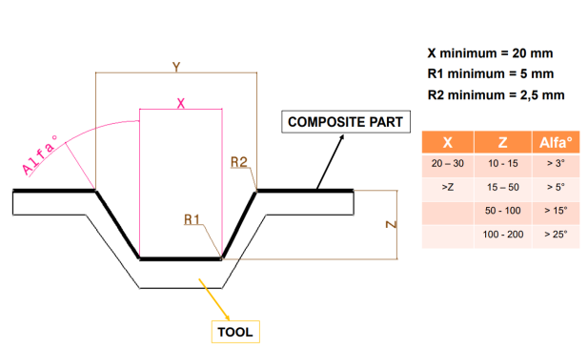
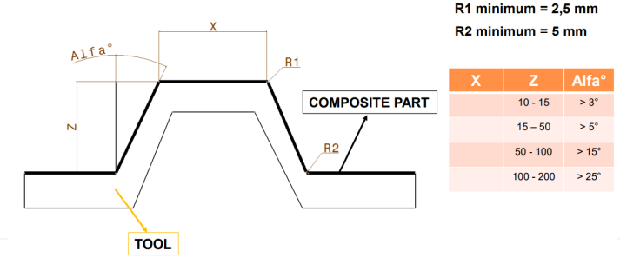
Design Guidelines
Draft Angle

Slide 25
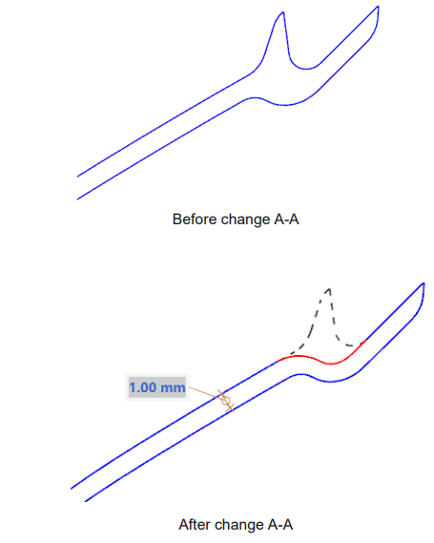
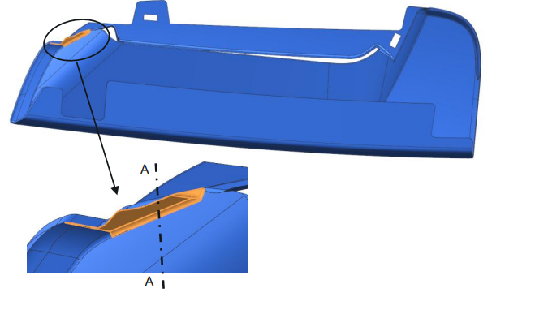
Design Guidelines
Sharpe Condition

Slide 26
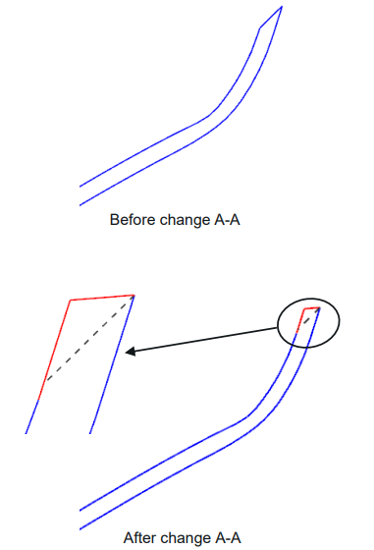
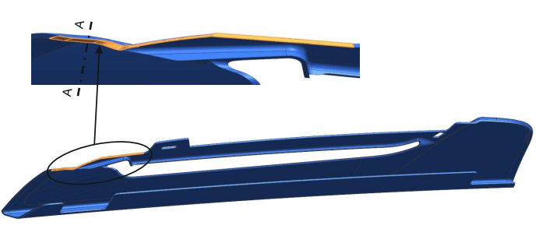
Design Guidelines
Uneven Edge

Slide 27
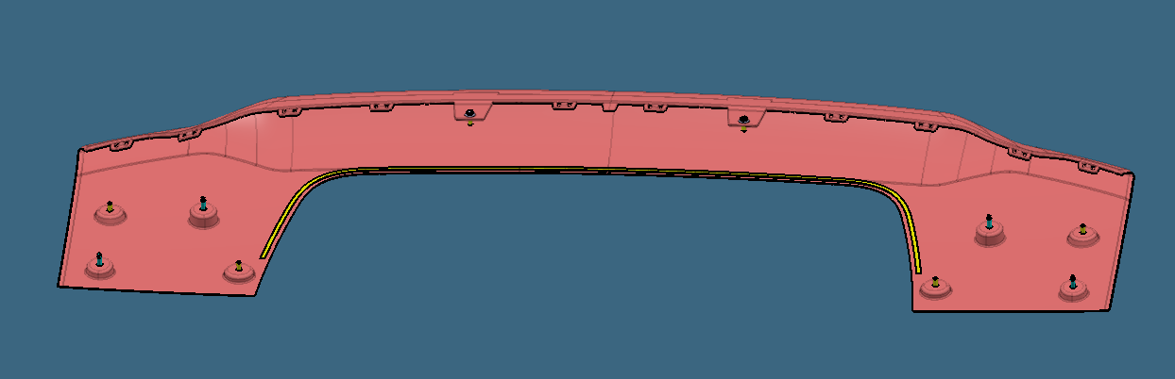
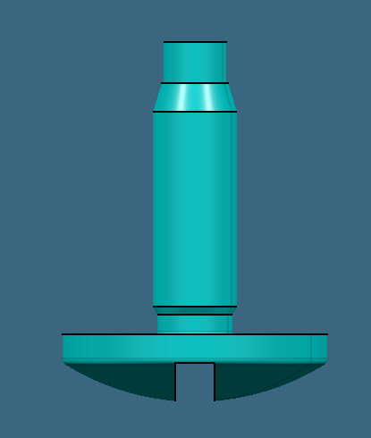
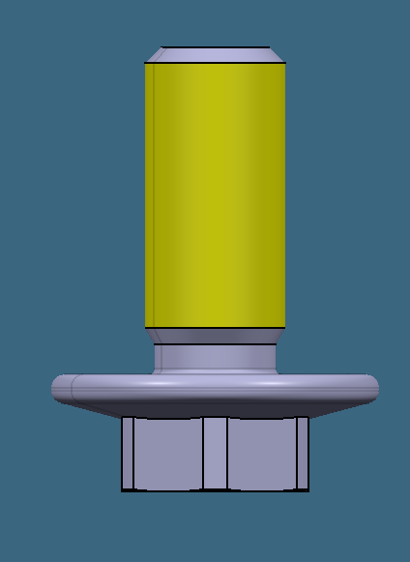
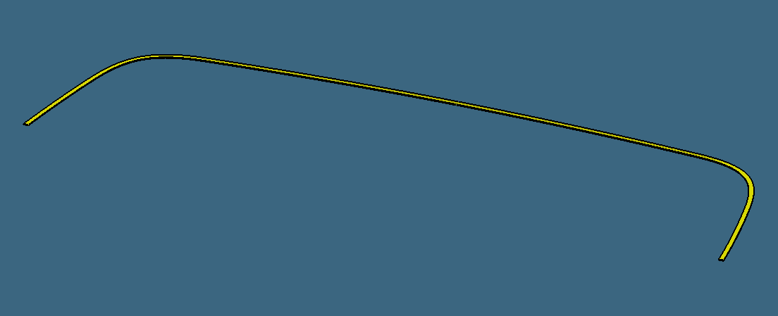
Assembly of Carbon Fiber
Fixing type
BOLT M6X18 TRUSS SLOT PIL 8
3M TAPES
BOLT M6X14 HF HITEMP

Slide 28
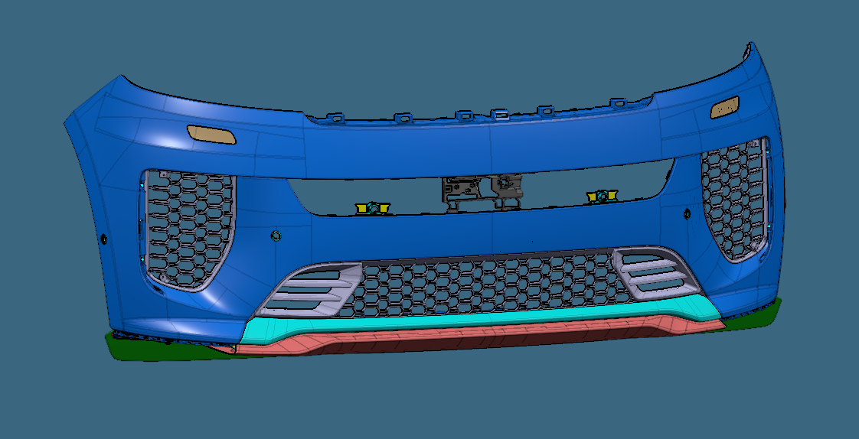
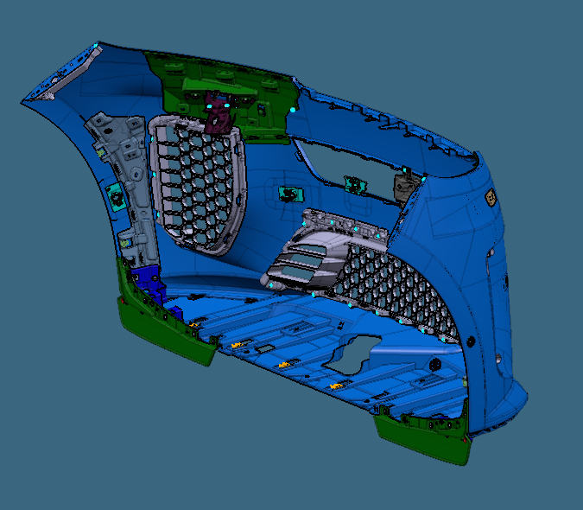
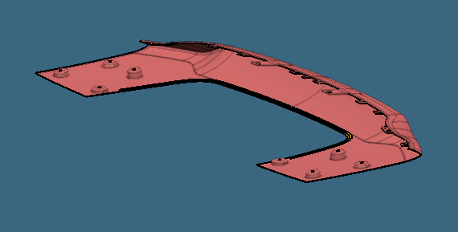
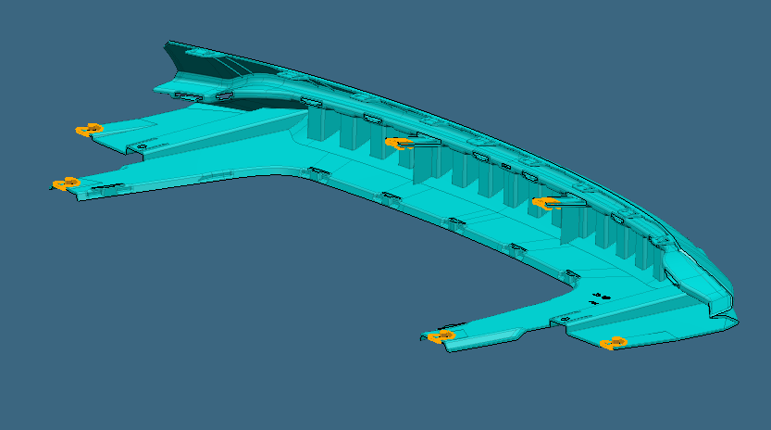
Assembly of Carbon Fiber
Assembly Path

Slide 29
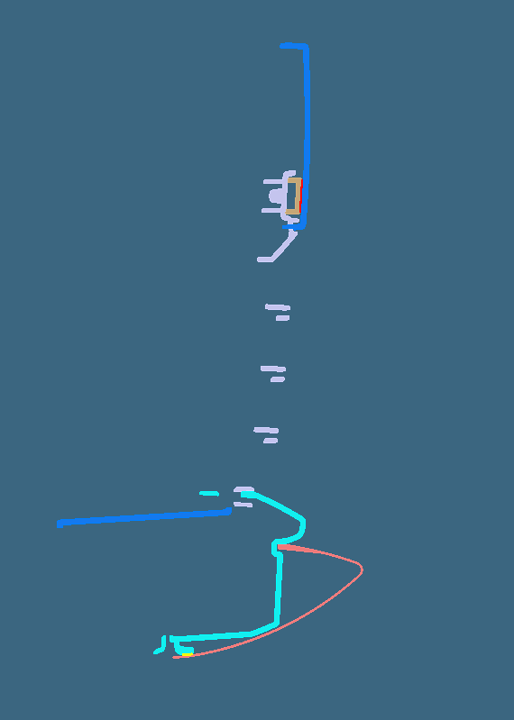
Assembly of Carbon Fiber
Y0 section
Bumper
Grille
Upper Splitter
Lower Splitter CF

